Slide 1
Festina lente Developments and Mission of a University Press in the Context of an Infrastructural Project Dr. Andrea Bertino (SUB Göttingen) 2nd AEUP Conference: (Re-)Shaping University Presses and Institutional Publishing Brno, Czech Republic, 13-14 June 2019
Notes:
I owe you some brief explanations on this title, which, as many of you have already noticed, takes up a maxim used some centuries ago by one of the most important and polyhedral personalities in the history of the book, Aldo Manuzio, publisher, great humanist, philologist, printer and entrepreneur.

Slide 2
Notes:
"Festina lente", "Make haste slowly": for two reasons I decided to use for the title of this presentation the famous adage already used by Aldo Manuzio, one of the fathers of the modern book, in his typographic brand. Not only because there are similarities between our time and the time of Manuzio in terms of strong innovations in the field of scientific publishing. Of course, if our age is the age of digitization and open science, Manuzio was the forerunner of the paperback, the italic font, the first to print books in ancient Greek, and the first, like the example on the slide, that uses a kind of permanent identifier for publishers, the typographic brand. Moreover, his multi-faceted figure - a humanist, a well-trained Greekist and Latinist, translator, printer and businessman - corresponds in some way to the variety of skills a publisher needs today to be good in an extremely complex environment.
But the main reason I have used this motto is because I think it can represent something of the dynamic characterizing, or that should characterize, the involvement of a university press in an infrastructure project aiming to improve the scientific book. I would like to present these idea today by focusing on the exemplary case of the Göttingen University Press and its role in the HIRMEOS project. In the last part of my presentation I will also try to generalize my specific experiences and formulate some insights that will hopefully be useful for other people working in similar contexts.

Slide 3
Göttingen University Press
Established in 2003
appr. 50 -55 book projects per year with 2.75 FTE – makes 6 persons
More than 820 books published up to now
In the University for the University
publishing program a reflection of university portfolio
High-level delegates of each faculty in editorial board
editorial board serves as steering committee and is responsible for the review process
Authors contribute to publishing process to minimise costs – responsible for formatting

Slide 4
Göttingen University Press & Open Access
Part of the university‘s Open Access service portfolio
Open Access mandatory for authors and editors (cc-by-sa 4.0 default)
Integration into OAPEN and DOAB
Some publications in OpenEdition

Slide 5
Notes:
Since January 2017, Göttingen University Press, together with OAPEN, OPENEDITION, EKTePublishing and Ubiquity press, has been one of the five platforms that the HIRMEOS project operates until the end of this month, trying to implement new services and tools for the digital monograph.
I will not be presenting the HIRMEOS services in detail again because Pierre spoke about it yesterday.
For each service I will try to give some brief examples of how the participation in HIRMEOS has changed the way in which the user can interact with monographs published by Göttingen University press and I will give some examples of how the services implemented have an impact on the concrete work processes of the university press.

Slide 7
Notes:
For this purpose, the GUP publishing system has been improved to include support for editorial staff by automatically finding
and saving the ORCID of the authors of a book.
A concrete EXAMPLE, In the metadata form of the submission workflow a "Lookup" button was implemented next to each
Author so that after entering the name a search in the ORCID registry can be triggered.

Slide 8
Notes:
Description entity-fishing. Wordclouds, Timeline, List of name with wikipedia definition

Slide 14
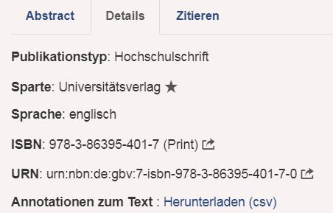

Slide 16
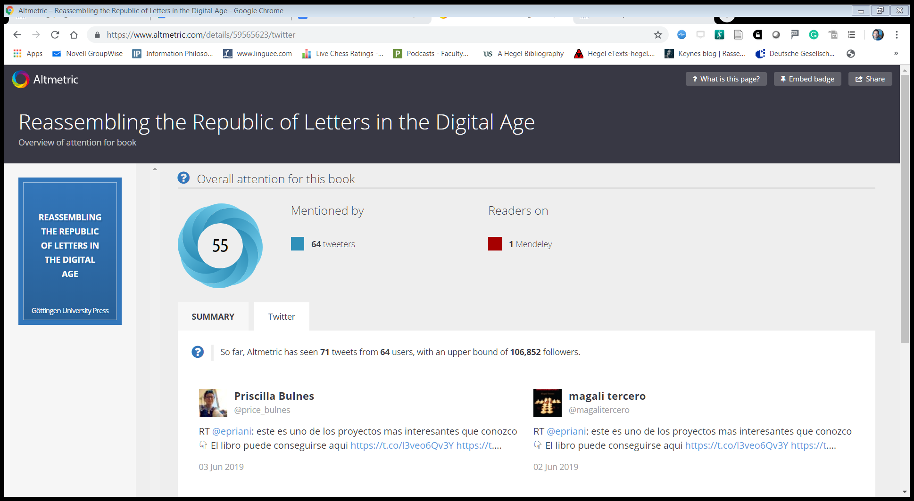

Slide 17
University Presses and infrastructural Projects General Thesis
The University Press as a glocal actor
‘By participating in infrastructural projects, also the small, non-profit university presses, while primarily designed for local academic communities, can influence the development of the entire publishing landscape and contribute to the preservation of bibliodiversity’
Notes:
I will now end by trying to formulate some general considerations about the importance of infrastructure projects for university presses in general. This consideration results from experiences with HIRMEOS and the university press. Unfortunately, I am neither a publisher nor a librarian and apologize if anything can be naive, but I hope that there will at least be something that can stimulate discussion.
On the background of these experiences I would now like to formulate a general thesis that can be applied to other publishing houses, not only to German ones, although there are very large differences in the individual countries.
Local action to bring about global change. My idea is that this role of the global player of a publishing house initially operating at the local level is possible because many university publishers have a privileged or at least favorable position for their participation in the adventure of improving the use and dissemination of the digital book.

Slide 18
Why and how University Presses can take care of Bibliodiversity
Problem 1: To small to have any impact on the global publishing system
Problem 2: No motivation to change well consolidated workflows when their work is absolutely satisfactory for the local community
Possible Solution: Participating in infrastructural projects and making a commitment in front of a consortium .
But if that doesn't happen…
…There is a risk that the future of the OA book will be shaped exclusively by large commercial publishers, which could mean that past distorsions of the publishing system will continue to exist
Notes:
No motivation to change well consolidated workflows and take advantage of this privileged position when their work is absolutely satisfactory for the local community. Problem psychological and organizational motivation limit: a person or institution that already provides a very good service at local level tends to remain in a comfort zone without an external impulse. In order to feel an incentive to actively take responsibility for global change, they need obligations towards third parties.
Making a commitment to a consortium and other partners is not only a way to attract resources, but also forces us to do things that otherwise would not be urgently needed, even though we know they can potentially be useful.

Slide 19
University Presses as glocal Actors in the transition to the OA Monograph
‘University presses may enjoy a privileged position’
Freedom to experiment on services without knowing whether they turn out to be useful or profitable
Editorial boards representing the local academic community
Links with funding institutions
Involvement in the policies and strategies of their university, especially for OA and OS
Notes:
Yesterday it was said that being small is not necessarily a handicap. One can even go further and say that University press can enjoy a privileged position , above all when their efficiency on a local basis is complemented by participation in a wider context such as that of a research infrastructure or a structural project.
The choice to participate should in many cases be seen as the natural consequence of their privileged position.
If they become aware of this position , they can play a central role in the process of changing both national and international publication systems.
This privileged position, is a call for responsibility for the entire system. Simple subsistence is not enough to guarantee bibliodiversity, in the meanwhile other gatekeepers take a monopolistic position.

Slide 20
University Presses as Project Partners: Conditions for a successful participation
Monograph, as laboratory of the HSS, not to be replaced by other forms of publication
Reallization, publication and use of monographs can benefit from technical innovations
Sharing general convictions and commitments – core identity of a strong community
'Festina lente‘
Evaluating the impact of new technical implementations
Sustainability in the long term
Ongoing workflows and skills of available officers
Organisational, technical and communicative skills
Ability to ‘translate’ between different technical languages and bring people with different backgrounds and working cultures into dialogue.
Broading the spectrum of involved professional figures
Notes:
monograph not to be replaced by other forms of publication.
Laboratory of the HSS to develop long argumentations both systematically and historically. Value of the traditional monograph not in contradiction to technical innovation Creation, publication and use of monographs can benefit from technical innovations
What are the prerequisites for successful participation in infrastructure projects? I consider at least three of them.
1) Among the specific values and beliefs that give substance to this idea of fellowship, there are certainly some basic values of the scientific monograph. Today's participation as a university publisher in an infrastructural project for the human or social sciences presupposes that at least two basic ideas are shared, namely that
2. there needs to be some willingness to carefully assess the impact of these changes on the way books are produced and how people in general work in a publishing house, and the long-term sustainability challenges they pose.
Finally, it is essential to be prepared to broaden the professional profiles of staff involved in publishing activities, including professionals responsible for exchanges between different communities, and to mediate between different languages.

Slide 21
University Presses as Project Partners: Challenges and Difficulties
Jobs in public institutions not always attractive for IT-people → Frequent changes in staff → delays and difficulties in implementation
Not too strong involvement of the editorial board in the validation of the proposed implementations (e.g: survey on entity-fishing)
University press only as a local service, not an option for authors from other universities
Notes:
The position of programmers in public employment is not attractive enough
frequent changes in staff, delays in implementation
Lack of strong involvement of the editorial board in the evaluation of the proposed implementation (example: survey prepared by us not successful).
Only local service, lack of flexibility and discretion in supporting the publications of authors from other universities

Slide 22
University Presses as Project Partner: Possible Solutions
Improving the working conditions of IT people
Competence exchange between university presses → networks and infrastructure like OA Books Network, OPERAS RI etc.
Outsourcing of services
Renew the editorial board with people more interested in technical incentives for Open Access books, possibly including young researchers and even a student representative
Building consortia with other university presses to fund publications by authors from universities without an own publishing service
Notes:
Exchange of expertise between university publishers through opportune networks → OA Books Networks
Outsourcing of services .
Improving the working conditions of programmers. If public institutions want to be protagonists they have to do it - consortium solutions for local problems
Improving the working conditions of IT people
Recreate the editorial board with members more sensitive to technical incentives for monographs in Open Access, involve new generations, not only professors but also researchers and at least one student representative.
Inter-university consortia and funds for the publication of OA monographs, so that even authors who have no university publishers at their institution do not have to pay a lot of money to commercial publishers to publish an OA monograph.

Slide 23
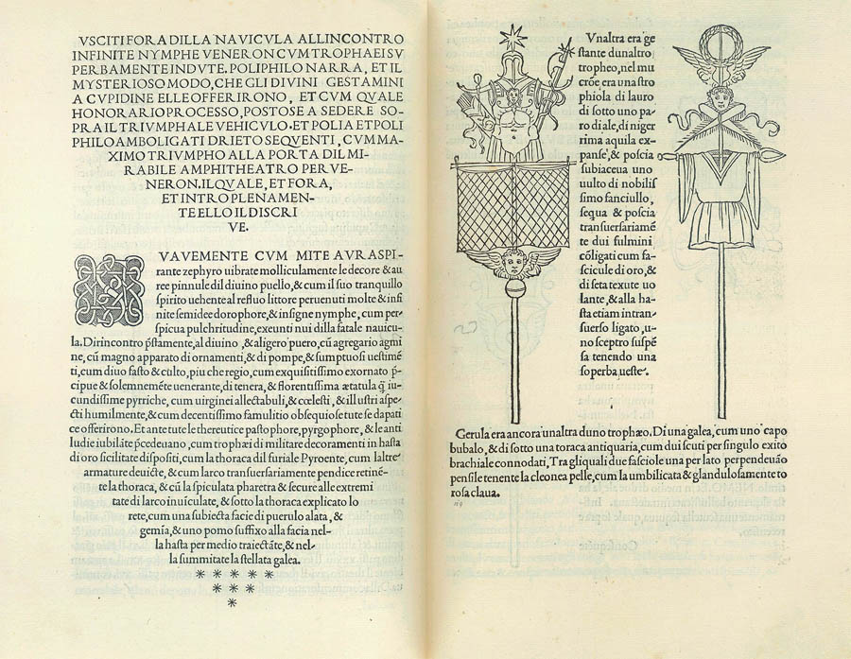
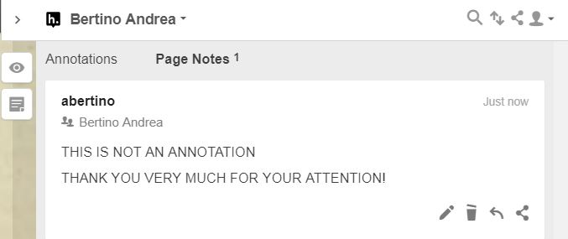
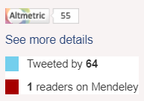
Notes:
I would like to conclude by returning a little to the beginning of the presentation just to express the hope that the university presses of the future know how to combine something of the beauty of the European book tradition with truly useful and functional services.

